Slide 1

CSE499B RESEARCH PRESENTATION

Slide 2
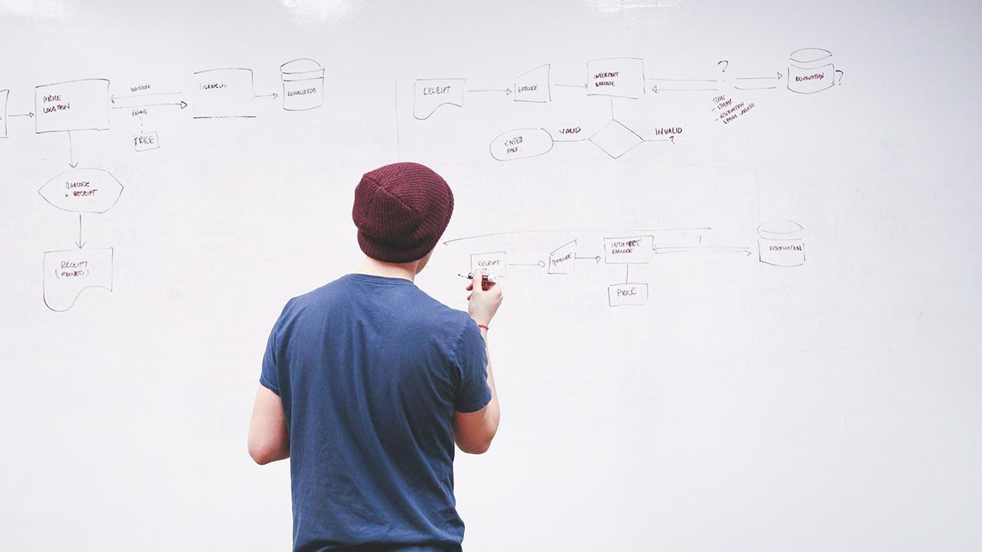
GROUP MEMBERS-
Md. Abdur Rakib Rahat
1620521042
Md. Raihan Hossain
1520566642
Sumaya Yeacin Rimu
1530664042
Anwar Shadaab
1611383042

Slide 3
Topic Name: An Analysis to deremine how e-commerce sites implement their business strategies using the dark web and to examine whether it works differently for regular internet e-commerce sites.

Slide 4
PROBLEM:
The problem was to find a vast information, related to E-Commerce Websites of Dark Web and to find how it works, how sellers sell and buyers buy from those sites. The comparison with the e-commerce websites of Surface Web not only in terms of structural difference but also the functional difference.

Slide 5
COMPLETION:
We have done some literature review of papers related to the E-Commerce Websites of Dark Web. We tried performing Web Crawling on Dark Web sites. From some papers and from searching, we found some information regarding how buyers buy and sellers sell products on Dark Web. We tried to find some positivity about Dark Web because it looks like full of illegal activities such as Fraud Credit Card Selling, Gun & Drugs selling, Illegal Pornography and stolen electronic products, Hitman Contract and many more. We also tried to enter the Dark Web e-commerce sites and open account to explore.

Slide 6
TERM-BREAK WORKS:
During the Term break, our focus was on to perform Web Crawling on Dark Net websites and to order some products to understand the buying procedure of products more accurately.

Slide 7
NEXT TWO-MONTHS PLANS:
The plan for next two months is to find a web crawling technique that will work properly because we tried to web crawl previously but it didn’t work on Dark Net websites. Also we have a plan to review more papers in order to strengthen our research purpose. Ordering product from dark web is very difficult to do but we will try again soon.

Slide 8
REPORT WRITTING PLAN:
We will plan to write a report about our research as like as paper. So, we decided to complete all the result from our collected data and make a report. And, we also add in our report some literature review which helps us, some algorithms which we will use and which are can be used. And also we will mention our research methodology. Hope so, we will complete our report before capstone project show.

Slide 9
CAPSTONE PROJECT SHOW PREPARATION:
For Capstone Project Show, we need some results from various research aspect that could be easily shown to Capstone Project Show where people can easily understand by only looking at the result what we want to represent there.

Slide 10
POSTER MAKING:
We will prepare to make poster without our research result but not prepare for Final poster making. Because, our result didn’t come out properly and we also working on it. For Poster making we have show our total outcome and calculated research things. And we have to show some literature review for poster. So we prepare for all this without our market analysis research result.

Slide 11
PAPER PUBLISH:
We want to write a paper. And confident for this because our way of work and and we can compare dark web market area. And we think it can make ourselves to publish a paper about this research.

Slide 12
CHALLENGING PART OF THIS RESEARCH:
The most challenging part of our project is to Web Crawling the e-commerce websites of Dark Web. The reason is most of the e-commerce websites don’t allow to crawl into their websites, they somehow blocked it. And also the lacking of technique for web crawling Dark Net websites is also a problem. We found two-three techniques in the internet, but it did not perform correctly. Also ordering product from Dark Net websites is also a difficult thing because it has to done via bitcoin and also risky for students like us to order from Dark Web.

Slide 13
THANKS!

